Slide 1

CampusAI EnergyWise
AI-Powered Campus Energy Optimization & Sustainability Advisor
Shwetanjali Gautam
Birla Institute of Technology (BIT), Mesra

Slide 2


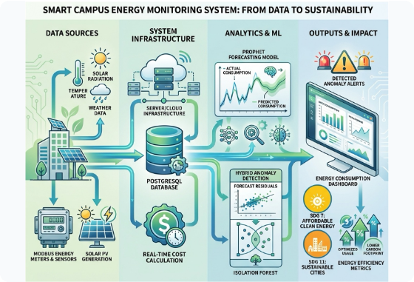
Project Overview
Actionable Campus Sustainability
Campus energy data is frequently logged as raw readings, but translating numerical spikes into timely, understandable action remains a key operational bottleneck.
Numerical & GenAI Synthesis: Combines statistical anomaly detection with plain-language recommendations.
Prototype Scope: Focuses on Academic, Hostel, and Laboratory blocks using synthetic baseline data.
Human-in-the-Loop: AI serves as a decision-support advisor; facility staff approve interventions.

Slide 3






UN SDG Alignment
Primary: SDG 7
Secondary: SDG 12
Supporting: SDG 13
Affordable & Clean Energy
Responsible Consumption
Climate Action
Directly addresses Target 7.3 by doubling the global rate of improvement in energy efficiency through intelligent building energy management.
Promotes sustainable campus operations and efficient resource consumption by eliminating unnecessary electricity wastage.
Converts measured energy savings into quantifiable greenhouse gas emission reductions using regional grid emissions factors.

Slide 4


Problem Statement & Gap
Core Problem Question
The Operational Gap
"How might we use AI to identify campus energy-use patterns and generate responsible, actionable recommendations so buildings can operate efficiently?"
Raw meter logs and spreadsheet exports state what was consumed, but fail to explain why abnormal consumption occurred or what steps facility managers should take immediately.
Without contextual guidance, energy waste persists until monthly billing reviews occur.
Educational institutions consume significant electrical energy across various facility types, but lack real-time context to act swiftly on anomalies.

Slide 5

Target Users & Responsibilities
User Persona | Primary Responsibility | AI Value Proposition
Facility Manager | Reviews building performance & authorizes changes | Instant high-risk alerts & prioritized action plans
Maintenance Team | Investigates HVAC, lighting & hardware faults | Diagnostic insights pinpointing probable root causes
Sustainability Committee | Tracks long-term KPIs & campus policies | Historical efficiency reports & policy auditing
Students & Staff | Occupies campus facilities daily | Fosters sustainability culture & transparent reporting

Slide 6
Why AI Integration?
Multi-Factor Pattern Recognition: Correlates energy consumption with occupancy %, ambient temperature, and facility context.
Baseline Demand Prediction: Projects expected baseline load based on historical observations to detect subtle drift.
Generative AI Synthesis: Converts numerical data into clear, natural language explanations and prioritized tasks.
Automated Orchestration: n8n workflows automate data ingestion, prompt building, and reporting seamlessness.

Slide 7


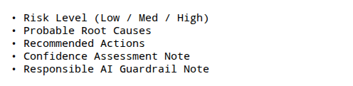
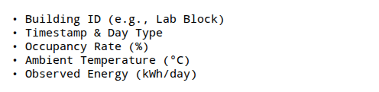
System Input & Output Architecture
Pipeline Input Vector
AI Diagnostic Output
Structured observations ingested via CSV or live API streams:
Structured JSON response for decision-support logging:

Slide 8




End-to-End Prototype Workflow
2. Normalize
Validate data types, handle missing values, and scale features.
4. GenAI Prompt
Construct structured context prompt with system guardrails.
1. Ingest Data
3. AI Prediction
Receive observation record or batch CSV file via n8n webhook.
Run baseline predictive model to flag statistical anomalies.

Slide 9

AI Prompt Engineering & Guardrails
System Prompt Architecture
Role Definition: You are a sustainability decision-support assistant for university facility operations.
100%
Zero Unsubstantiated Claims: Strictly prohibits claiming unverified energy or cost savings.
No Autonomous Switching: Prevents direct AI control over electrical or laboratory hardware.
Human Operational Authority
Enforced Schema: Guarantees structured output fields for seamless system integration.

Slide 10


Laboratory Block Scenario
Live Demonstration Instance
Observation Inputs: Occupancy: 22% | Ambient Temp: 31.2 °C | Energy: 1,430 kWh/day.
AI Diagnostic Response: High energy consumption flagged relative to low off-peak occupancy rate.
Recommended Interventions:
1. Audit HVAC cooling schedule for overnight override. 2. Inspect lab equipment standby power protocols. 3. Require facility manager operational sign-off.

Slide 11






Responsible AI Framework
Fairness & Context
Transparency & Privacy
Safety & Oversight
Uses building-specific historical baselines rather than assuming uniform consumption across diverse facility types.
Exposes all input variables to reviewers; operates strictly on aggregated building data to protect student privacy.
Preserves human oversight for all operational changes; flags missing or implausible data readings automatically.

Slide 12
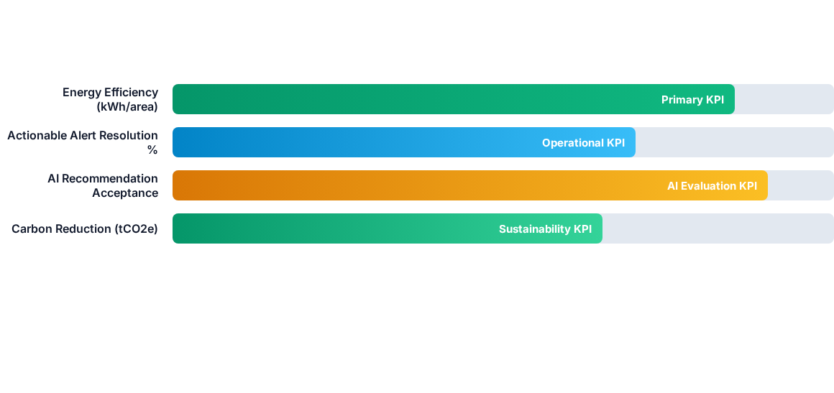
Prototype Evaluation Framework

Slide 13



Expected Impact Roadmap
Medium Term
Social Impact
Identification of recurring schedules to inform HVAC maintenance & shutdown plans.
Practical AI-for-Good learning model and heightened campus sustainability awareness.
Short Term
Long Term
Rapid interpretation of daily energy observations and automated anomaly flagging.
Direct smart meter API integration supporting continuous real-time optimization.

Slide 14
Testing & Validation Strategy
Data Pipeline Integrity: Systematically test data handling for missing, duplicate, and extreme outlier sensor values.
Statistical Predictive Metrics: Evaluate model baseline accuracy using (Mean Absolute Error) and metrics on held-out test datasets.
Expert Human Review: Facility management professionals assess AI diagnostic output for practical safety and relevance.
Controlled Pilot Interventions: Pilot approved HVAC and lighting interventions and measure actual energy before and after.

Slide 15
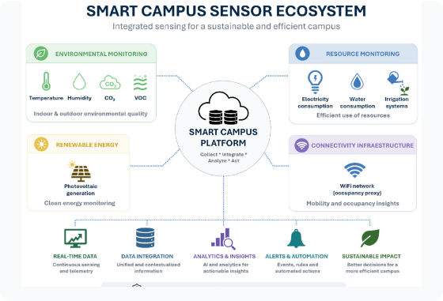
Limitations & Future Roadmap
Current Limitations
• Prototype relies on synthetic data; needs live campus meter pilot. • Precise carbon tracking requires localized electricity emissions grid factors.
Future Scope
IoT Meter Integration: Live telemetry streams and ambient weather API integration.
RAG Framework: Retrieval-Augmented Generation over campus policies and equipment manuals.

Slide 16
CampusAI EnergyWise
PPT Presentation | Project Report | Sample CSV Dataset | Python Prototype | n8n Blueprint
Bridging AI and Sustainability for Smart, Energy-Efficient Campuses

Slide 17



Image Sources
https://www.preprints.org/frontend/manuscript/c977f3ac63abf0e571d636abc3fe2d18/download_pub/figure/graphic_abstract.jpg
Source: www.preprints.org
https://www.csemag.com/wp-content/uploads/2025/09/CSE2509_MAG_MEP_Medical_School_Lab-1-576x1024.jpg
Source: www.csemag.com
https://www.mdpi.com/applsci/applsci-16-07346/article_deploy/html/images/applsci-16-07346-g001.png
Source: www.mdpi.com

